Slide 1
String, Char
Chapter 7
Ebook: Beginning Visual C# 2010, chapter 5
Reference: C# How to Program, chapter 15

Slide 2
Contents
String class
StringBuilder class
Char class

Slide 3
Declare and Initialing strings
Used as a type:
Example: string st = "Dai Hoc Cong Nghiep";
Used as a class:
new string (char[] mang_ki_tu);
new String (char[] mang_ki_tu, int vi_tri_bat_dau, int so_ki_tu);
new String (char ki_tu, int so_lan_lap);
…
string var_name;
string var_name = "value";

Slide 4
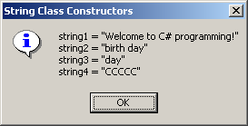
Example: Declare and Initialing strings
string output;
string originalString, string1, string2, string3, string4;
char[] characterArray = { 'b', 'i', 'r', 't', 'h', ' ', 'd', 'a', 'y' };
originalString = "Welcome to C# programming!";
string1 = originalString;
string2 = new string( characterArray );
string3 = new string( characterArray, 6, 3 );
string4 = new string( 'C', 5 );
output = "string1 = " + "\"" + string1 + "\"\n" +
"string2 = " + "\"" + string2 + "\"\n" +
"string3 = " + "\"" + string3 + "\"\n" +
"string4 = " + "\"" + string4 + "\"\n";
MessageBox.Show( output, "String Class Constructors",
MessageBoxButtons.OK, MessageBoxIcon.Information );
Notes:
String4: tham số là ký tự và số lần lặp ký tự đó.

Slide 5
String indexer, Length property
String indexer
Retrieval of any character in the string (using [] operator)
Length property
Returns the length of the string
Example:
string st = "abc", output="";
for (int i=st.Length-1; i>=0; i--)
output += st[i];
lblOutput.Text = output;
Notes:
String s=“abcxyz”;
Char c = s[2];

Slide 6
String comparing methods
Compare (static method)
Compares the values of two strings
Returns an integer value:
string 1 = string 2 → 0
string 1 > string 2 → 1
string 1 < string 2 → -1
CompareTo (not static method)
Compares the current string object to another string
Returns an integer value (same as Compare method)
Equals
Determines whether two strings are the same
Returns true if two strings are the same

Slide 7
String comparing methods (cont)
Example 1:
string st1 = "hello", st2 = "good bye";
if (st1.CompareTo( st2 ) == 0)
// xử lý hai chuỗi giống nhau
else if (st1.CompareTo( st2 ) > 0)
// xử lý st1 lớn hơn st2
else
// xử lý st1 nhỏ hơn st2
Example 2:
string st1 = "hello", st2 = "HELLO";
if ( st1.Equals( st2 ))
lblKQ.Text = "Hai chuỗi giống nhau";
else lblKQ.Text = "Hai chuỗi khác nhau";

Slide 8
String checking methods
StartsWith
Determines whether a string begins with the string passed, if yes, returns true
EndsWith
Determines whether a string ends with the string passed, if yes, returns true
Contains
Determines whether a string contains the string passed, if yes, returns true

Slide 9
String checking methods (cont.)
Example:
string[] strings = { "started", "starting", "ended", "ending" };
string output = "";
// test every string to see if it starts with "st"
for ( int i = 0; i < strings.Length; i++ )
if ( strings[i].StartsWith( "st" ) )
output += strings[ i ];
rtxOutput.Text = " Strings starts with st:\n" + output;

Slide 10
Locating characters and substrings in strings
Finding the index of string (or char) in the other string, return -1 if not found
IndexOf
Returns the first occurence index of character or string in this instance
LastIndexOf
Returns the last occurence index of character or string in this instance

Slide 11

Locating characters and substrings in strings
Example:
string letters = "abcdefghijklmabcdefghijklm";
rtxOutput.Text = letters + "\n";
rtxOutput.Text += "'c' is located at index " + letters.IndexOf( 'c' );
rtxOutput.Text += "\n";
rtxOutput.Text += "'a' is located at index " + letters.IndexOf('a',1);
rtxOutput.Text += "\n";
rtxOutput.Text += "Last ‘def’ is located at index " + letters.LastIndexOf( "def" );

Slide 12
Characters trimming and removing methods
String’s contents never change
Trim
Removes white spaces from the beginning and end of a string
TrimEnd
Removes characters specified in an array of characters from the end of a string
TrimStart
Removes characters specified in an array of characters from the beginning of a string
Remove
Removes a specified number of characters from a specified index position in a string

Slide 13
Miscellaneous String methods
ToUpper
Converts all characters in a string to uppercase
ToLower
Converts all characters in a string to lowercase
Format
Builds a formatted string from a set of input objects

Slide 14
Miscellaneous String methods
Example:
string st1 = "cheers!";
string st2 = "GOOD BYE ";
lblHoa.Text = st1.ToUpper();
lblThuong.Text = st2.ToLower();

Slide 15
Extracting substrings from strings
Substring
Returns a substring from this instance
Substring (int startIndex, int length)
Substring (int startIndex)
Example:
string s1 = "Nguyen Thi Be Ba";
string s3;
txtName.Text = s1.Substring (11); // ?
s3 = s1.Substring ( 0, s1.IndexOf (" ") ); //s3 = ?, s1 = ?
s1 = s1.Substring (s1.LastIndexOf (" ") + 1 ); //s1 = ?

Slide 16
Replacing strings
Replace
Returns a string that replace all occurrences of this instance by a new string or character
Replace (String oldValue, String newValue)
Replace (char oldValue, char newValue)
Example:
string string1 = "cheers!";
// Replacing e with E in string1
lblChuoiMoi.Text = string1.Replace( 'e', 'E' );

Slide 17
Concatenating strings
Concat
Concatenating strings from two or more strings
Return a new string
Concat (String s1, String s2)
You can use + operator to concat strings
Example:
string string1 = "Happy ";
string string2 = "Birthday";
string s12 = String.Concat( string1, string2 );
lblOutput.Text = s12;

Slide 18
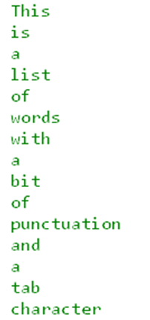
Split strings
Split
Returns an array of strings, where each element is a word
Takes an array of chars that indicate which characters are to be used as delimiters
Example:
string words = "This is a list of words, with: a bit of" + "punctuation\tand a tab character.";
string[] arWords = words.Split(new Char[] {' ', ',', '.', ':', '\t' });
foreach ( string s in arWords ) {
if (s.Trim() != "")
Console.WriteLine(s);
}

Slide 19
Split strings (cont.)
s
Example: Split a name
string s1 = “Nguyễn Văn An";
string[] s;
s = s1.Split (new char[]{' '}); //tham so truyen la mang ky tu
txtHo.Text = s[0];
txtTen.Text = s[s.Length-1];
for ( int i=1; i<s.Length-2; i++)
{
txtHolot.Text += s[i] + “ “;
}
Nguyễn
Văn
An

Slide 20
Contents
String class
StringBuilder class
Char class

Slide 21
StringBuilder class
StringBuilder class
Create and manipulate dynamic string information
Capable of resizing
Belongs to namespace System.Text
Objects of class String are constant strings (fixed length and value), whereas object of class StringBuilder are mutable strings so you can add, delete, replace characters in the objects
Notes:
The String class provides many capabilities for processing strings. However a string’s contents can never change.
(the += operator creates a new string and assigns the initial string reference to the newly created string)
When given the choice between using a String and a StringBuilder to represent a string, always use a String if string’s contents never change

Slide 22
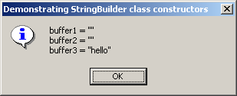
Example - StringBuilder class
StringBuilder buffer1, buffer2, buffer3;
string output;
buffer1 = new StringBuilder();
buffer2 = new StringBuilder( 10 );
buffer3 = new StringBuilder( "hello" );
output = "buffer1 = \"" + buffer1.ToString() + "\"\n";
output += "buffer2 = \"" + buffer2.ToString() + "\"\n";
output += "buffer3 = \"" + buffer3.ToString() + "\"\n";
MessageBox.Show( output, "Demonstrating StringBuilder class constructors",
MessageBoxButtons.OK, MessageBoxIcon.Information );

Slide 23
Append and AppendFormat methods
Append method
Allow various data-type values to append to the end of a StringBuilder
Convert argument into string
AppendFormat method
Convert string to a specifiable format
Notes:
Append nối vào, chấp vào

Slide 24
Example: Append method
object objectValue = "hello";
string stringValue = "good bye";
char[] characterArray = { 'a', 'b', 'c', 'd‘, 'e', 'f' };
bool booleanValue = true;
char characterValue = 'Z';
int integerValue = 7;
long longValue = 1000000;
float floatValue = 2.5F;
double doubleValue = 33.333;
StringBuilder buffer = new StringBuilder();
// use method Append to append values to buffer
buffer.Append( objectValue );
buffer.Append( " " );
buffer.Append( stringValue );
buffer.Append( " " );
buffer.Append( characterArray );
buffer.Append( " " );

Slide 25
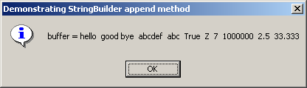
Example: Append method (cont.)
buffer.Append( characterArray, 0, 3 );
buffer.Append( " " );
buffer.Append( booleanValue );
buffer.Append( " " );
buffer.Append( characterValue );
buffer.Append( " " );
buffer.Append( integerValue );
buffer.Append( " " );
buffer.Append( longValue );
buffer.Append( " " );
buffer.Append( floatValue );
buffer.Append( " " );
buffer.Append( doubleValue );
MessageBox.Show( "buffer = " + buffer.ToString(), "Demonstrating StringBuilder append method“, MessageBoxButtons.OK, MessageBoxIcon.Information );

Slide 26
Example: AppendFormat method
StringBuilder buffer = new StringBuilder();
string string1, string2;
// chuỗi định dạng
string1 = "This {0} costs: {1:C}.\n";
// string1 argument array
object[] objectArray = new object[ 2 ];
objectArray[ 0 ] = "car";
objectArray[ 1 ] = 1234.56;
// append to buffer formatted string with argument
buffer.AppendFormat( string1, objectArray );

Slide 27
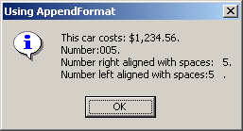
Example: AppendFormat method
// formatted string
string2 = "Number:{0:d3}.\n" + "Number right aligned with spaces:{0, 4}.\n" + "Number left aligned with spaces:{0, -4}.";
// append to buffer formatted string with argument
buffer.AppendFormat( string2, 5 );
// display formatted strings
MessageBox.Show( buffer.ToString(), "Using AppendFormat“, MessageBoxButtons.OK, MessageBoxIcon.Information );

Slide 28
Insert, Remove and Replace methods
Insert method
Insert into at any position
Program may throw ArgumentOutOfRangeException
Remove method
Takes two argument
Program may throw ArgumentOutOfRangeException
Replace method
Substitute specified string

Slide 29
Example: Insert, Remove method
object objectValue = "hello";
string stringValue = "good bye";
char[] characterArray = { 'a', 'b', 'c‘, 'd', 'e', 'f' };
bool booleanValue = true;
char characterValue = 'K';
int integerValue = 7;
long longValue = 10000000;
float floatValue = 2.5F;
double doubleValue = 33.333;
StringBuilder buffer = new StringBuilder();
string output;
// insert values into buffer
buffer.Insert(0, objectValue);
buffer.Insert(0, " ");

Slide 30
Example: Insert, Remove method
buffer.Insert(0, stringValue);
buffer.Insert(0, " ");
buffer.Insert(0, characterArray);
buffer.Insert(0, " ");
buffer.Insert(0, booleanValue);
buffer.Insert(0, " ");
buffer.Insert(0, characterValue);
buffer.Insert(0, " ");
buffer.Insert(0, integerValue);
buffer.Insert(0, " ");
buffer.Insert(0, longValue);
buffer.Insert(0, " ");
buffer.Insert(0, floatValue);
buffer.Insert(0, " ");
buffer.Insert(0, doubleValue);
buffer.Insert(0, " ");

Slide 31
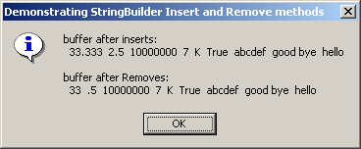
Example: Insert, Remove method
output = "buffer after inserts: \n" + buffer.ToString() + "\n\n"; → buffer = ?
buffer.Remove( 10, 1 ); // delete 2 in 2.5
buffer.Remove( 2, 4 ); // delete .333 in 33.333
output += "buffer after Removes:\n" + buffer.ToString(); → buffer = ?
MessageBox.Show( output, "Demonstrating StringBuilder " + "Insert and Remove methods", MessageBoxButtons.OK, MessageBoxIcon.Information );

Slide 32
Example: Replace method
StringBuilder builder1 = new StringBuilder( "Happy Birthday Jane" );
StringBuilder builder2 = new StringBuilder( "good bye greg" );
string output = "Before replacements:\n" + builder1.ToString() + "\n" + builder2.ToString();
//thay Jane bằng Greg trong chuỗi builder1
builder1.Replace( "Jane", "Greg" );
//thay g bằng G trong chuỗi builder2 từ vị trí 0, trong 5 ký tự đầu
builder2.Replace( 'g', 'G', 0, 5 );
output += "\n\nAfter replacements:\n" + builder1.ToString() + "\n" + builder2.ToString();

Slide 33
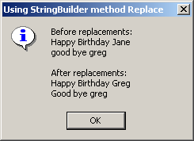
Example: Replace method
MessageBox.Show( output, "Using StringBuilder method Replace",
MessageBoxButtons.OK, MessageBoxIcon.Information );

Slide 34
Contents
String class
StringBuilder class
Char class

Slide 35
Char methods
ToUpper
ToLower
IsLower
IsUpper
IsPunctuation
IsSymbol
IsWhiteSpace

Slide 36
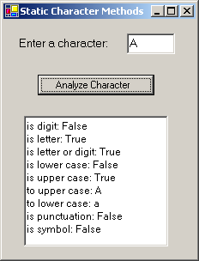
Example: Char methods
char character = Convert.ToChar( inputTextBox.Text );
string output;
output = "is digit: " + Char.IsDigit( inputCharacter ) + "\r\n";
output += "is letter: " + Char.IsLetter( inputCharacter ) + "\r\n";
output += "is letter or digit: " + Char.IsLetterOrDigit( inputCharacter ) + "\r\n";
output += "is lower case: " + Char.IsLower( inputCharacter ) + "\r\n";
output += "is upper case: " + Char.IsUpper( inputCharacter ) + "\r\n";
output += "to upper case: " + Char.ToUpper( inputCharacter ) + "\r\n";
output += "to lower case: " + Char.ToLower( inputCharacter ) + "\r\n";
output += "is punctuation: " + Char.IsPunctuation( inputCharacter ) + "\r\n";
output += "is symbol: " + Char.IsSymbol( inputCharacter );
outputTextBox.Text = output;

Slide 37
15.17 Regular Expression and Class Regex
Regular expression
Facilitate the construction of compiler
Validate the syntax of a program
Class Regex
System.Text.RegularExpressions namespace
An immutable regular expression
Method Match
Return object of class Match
Method Matches
Return a MatchCollection object
Class Match
A regular expression matching operation
Notes:
Regular expressions are specially formatted strings used to find patterns in text and can
be useful during information validation, to ensure that data is in a particular format. For example,
a ZIP code must consist of five digits, and a last name must start with a capital letter.
Hai lớp được thêm vào trong namespace .NET cho phép chúng ta thực hiện việc tìm kiếm
một chuỗi một cách lập đi lặp lại cho đến hết chuỗi, và kết quả trả về là một tập hợp. Tập hợp
được trả về có kiểu là MatchCollection, bao gồm không có hay nhiều đối tượng Match. Hai
thuộc tính quan trọng của những đối tượng Match là chiều dài và giá trị của nó,

Slide 38
15.17 Regular Expressions and Class Regex
Notes:
A word character is any alphanumeric character or underscore. A whitespace character
is a space, a tab, a carriage return, a newline or a form feed. A digit is any numeric
character.
Regex theReg = new Regex(@”(\S+)\s”);
Chuỗi \S tìm ký tự không phải ký tự trắng và dấu cộng chỉ ra rằng có thể có một hay nhiều ký
tự. Chuỗi \s (chữ thường) chỉ ra là khoảng trắng. Kết hợp lại là tìm một chuỗi không có
khoảng trắng bên trong nhưng theo sau cùng là một khoảng trắng. Chúng ta lưu ý khai báo
chuỗi biểu thức quy tắc dạng chuỗi nguyên văn để dễ dàng dùng các ký tự escape như (\).

Slide 39
15.17 Regular Expressions and Class Regex

Slide 40
RegexMatches.cs
Represent a two digit number
“.*” matches any number of unspecified characters
Match only digits in the range 0 – 3 and 5 - 9
“\d” will match any numeric digit
Character “J” is a literal character
1 // Fig. 15.20: RegexMatches.cs
2 // Demonstrating Class Regex.
3
4 using System;
5 using System.Windows.Forms;
6 using System.Text.RegularExpressions;
7
8 // test out regular expressions
9 class RegexMatches
10 {
11 // The main entry point for the application.
12 [STAThread]
13 static void Main( string[] args )
14 {
15 string output = "";
16
17 // create regular expression
18 Regex expression =
19 new Regex( @"J.*\d[0-35-9]-\d\d-\d\d" );
20
21 string string1 = "Jane's Birthday is 05-12-75\n" +
22 "Dave's Birthday is 11-04-68\n" +
23 "John's Birthday is 04-28-73\n" +
24 "Joe's Birthday is 12-17-77";
25
26 MatchCollection theMatches = expression.Matches( string1 );
27
28 foreach ( Match myMatch in theMatches )
29 output += myMatch.ToString() + "\n";
30
Notes:
Regex expression = new Regex( @"J.*\d[0-35-9]-\d\d-\d\d" );
→ Chuỗi bắt đầu với J,
. bất kỳ ký tự đơn nào trừ ký tự xuống dòng
.* số lượng ký tự không giới hạn

Slide 41
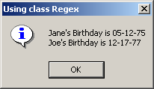
RegexMatches.cs Program Output
31 MessageBox.Show( output, "Using class Regex",
32 MessageBoxButtons.OK, MessageBoxIcon.Information );
33
34 } // end method Main
35
36 } // end class RegexMatches
Output show the two matches from string1 that have same pattern specified

Slide 42
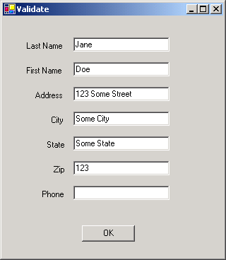
Validate.cs
1 // Fig. 15.22: Validate.cs
2 // Validate user information using regular expressions.
3
4 using System;
5 using System.Drawing;
6 using System.Collections;
7 using System.ComponentModel;
8 using System.Windows.Forms;
9 using System.Data;
10 using System.Text.RegularExpressions;
11
12 // use regular expressions to validate strings
13 public class ValidateForm : System.Windows.Forms.Form
14 {
15 private System.Windows.Forms.Label phoneLabel;
16 private System.Windows.Forms.Label zipLabel;
17 private System.Windows.Forms.Label stateLabel;
18 private System.Windows.Forms.Label cityLabel;
19 private System.Windows.Forms.Label addressLabel;
20 private System.Windows.Forms.Label firstLabel;
21 private System.Windows.Forms.Label lastLabel;
22
23 private System.Windows.Forms.Button okButton;
24
25 private System.Windows.Forms.TextBox phoneTextBox;
26 private System.Windows.Forms.TextBox zipTextBox;
27 private System.Windows.Forms.TextBox stateTextBox;
28 private System.Windows.Forms.TextBox cityTextBox;
29 private System.Windows.Forms.TextBox addressTextBox;
30 private System.Windows.Forms.TextBox firstTextBox;
31 private System.Windows.Forms.TextBox lastTextBox;
32
33 private System.ComponentModel.Container components = null;
34

Slide 43
Validate.cs
35 // The main entry point for the application.
36 [STAThread]
37 static void Main()
38 {
39 Application.Run( new validateForm() );
40 }
41
42 // Visual Studio .NET generated code
43
44 // handles okButton Click event
45 private void okButton_Click(
46 object sender, System.EventArgs e )
47 {
48 // ensures no textboxes are empty
49 if ( lastTextBox.Text == "" || firstTextBox.Text == "" ||
50 addressTextBox.Text == "" || cityTextBox.Text == "" ||
51 stateTextBox.Text == "" || zipTextBox.Text == "" ||
52 phoneTextBox.Text == "" )
53 {
54 // display popup box
55 MessageBox.Show( "Please fill in all fields", "Error",
56 MessageBoxButtons.OK, MessageBoxIcon.Error );
57
58 // set focus to lastTextBox
59 lastTextBox.Focus();
60
61 return;
62 }
63

Slide 44
Validate.cs
“*” quantifier signifies that the second range of characters may occur zero or more times
64 // if last name format invalid show message
65 if ( !Regex.Match( lastTextBox.Text,
66 @"^[A-Z][a-zA-Z]*$" ).Success )
67 {
68 // last name was incorrect
69 MessageBox.Show( "Invalid Last Name", "Message",
70 MessageBoxButtons.OK, MessageBoxIcon.Error );
71 lastTextBox.Focus();
72
73 return;
74 }
75
76 // if first name format invalid show message
77 if ( !Regex.Match( firstTextBox.Text,
78 @"^[A-Z][a-zA-Z]*$" ).Success )
79 {
80 // first name was incorrect
81 MessageBox.Show( "Invalid First Name", "Message",
82 MessageBoxButtons.OK, MessageBoxIcon.Error );
83 firstTextBox.Focus();
84
85 return;
86 }
87
88 // if address format invalid show message
89 if ( !Regex.Match( addressTextBox.Text,
90 @"^[0-9]+\s+([a-zA-Z]+|[a-zA-Z]+\s[a-zA-Z]+)$" ).Success )
91 {
92 // address was incorrect
93 MessageBox.Show( "Invalid Address", "Message",
94 MessageBoxButtons.OK, MessageBoxIcon.Error );
95 addressTextBox.Focus();
96
97 return;
98 }
“\s” matches a single whitespace character
Notes:
The "^" and "$" characters match the positions at the beginning
and end of a string, respectively.

Slide 45
Validate.cs
“\d{5}” matches any five digits
Must be 5 digits, exactly
99
100 // if city format invalid show message
101 if ( !Regex.Match( cityTextBox.Text,
102 @"^([a-zA-Z]+|[a-zA-Z]+\s[a-zA-Z]+)$" ).Success )
103 {
104 // city was incorrect
105 MessageBox.Show( "Invalid City", "Message",
106 MessageBoxButtons.OK, MessageBoxIcon.Error );
107 cityTextBox.Focus();
108
109 return;
110 }
111
112 // if state format invalid show message
113 if ( !Regex.Match( stateTextBox.Text,
114 @"^([a-zA-Z]+|[a-zA-Z]+\s[a-zA-Z]+)$" ).Success )
115 {
116 // state was incorrect
117 MessageBox.Show( "Invalid State", "Message",
118 MessageBoxButtons.OK, MessageBoxIcon.Error );
119 stateTextBox.Focus();
120
121 return;
122 }
123
124 // if zip code format invalid show message
125 if ( !Regex.Match( zipTextBox.Text, @"^\d{5}$" ).Success )
126 {
127 // zip was incorrect
128 MessageBox.Show( "Invalid Zip Code", "Message",
129 MessageBoxButtons.OK, MessageBoxIcon.Error );
130 zipTextBox.Focus();
131
132 return;
133 }

Slide 46
Validate.cs
134
135 // if phone number format invalid show message
136 if ( !Regex.Match( phoneTextBox.Text,
137 @"^[1-9]\d{2}-[1-9]\d{2}-\d{4}$" ).Success )
138 {
139 // phone number was incorrect
140 MessageBox.Show( "Invalid Phone Number", "Message",
141 MessageBoxButtons.OK, MessageBoxIcon.Error );
142 phoneTextBox.Focus();
143
144 return;
145 }
146
147 // information is valid, signal user and exit application
148 this.Hide();
149 MessageBox.Show( "Thank You!", "Information Correct",
150 MessageBoxButtons.OK, MessageBoxIcon.Information );
151
152 Application.Exit();
153
154 } // end method okButton_Click
155
156 } // end class ValidateForm
Phone must be the form xxx-yyy-yyyy
The “^” and “$” expression forces regular expression to evaluate entire string

Slide 47

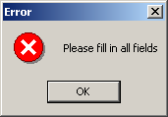
Validate.cs Program Output
Error message if TextBox left blank

Slide 48
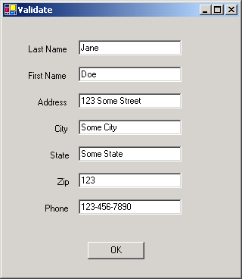
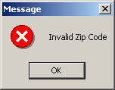
Validate.cs Program Output
Signal that the “Zip” TextBox was entered improperly

Slide 49

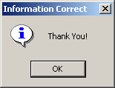
Validate.cs Program Output
Signify that all the TextBoxes were entered in correct format

Slide 50
RegexSubstitution.cs
Replace every instance of “*” in testString1 with “^”
Instantiates testRegex2 with argument @”\d”
Regular expression “stars” in testString1 is replaced with “carets”
Instance method Replace uses regular expression passed to constructor
1 // Fig. 15.23: RegexSubstitution.cs
2 // Using Regex method Replace.
3
4 using System;
5 using System.Text.RegularExpressions;
6 using System.Windows.Forms;
7
8 // Summary description for RegexSubstitution.
9 public class RegexSubstitution1
10 {
11
12 // The main entry point for the application.
13 static void Main( string[] args )
14 {
15 string testString1 =
16 "This sentence ends in 5 stars *****";
17
18 string testString2 = "1, 2, 3, 4, 5, 6, 7, 8";
19 Regex testRegex1 = new Regex( "stars" );
20 Regex testRegex2 = new Regex( @"\d" );
21 string[] results;
22 string output = "Original String 1\t\t\t" + testString1;
23
24 testString1 = Regex.Replace( testString1, @"\*", "^" );
25
26 output += "\n^ substituted for *\t\t\t" + testString1;
27
28 testString1 = testRegex1.Replace( testString1, "carets" );
29
30 output += "\n\"carets\" substituted for \"stars\"\t" +
31 testString1;
32
33 output += "\nEvery word replaced by \"word\"\t" +
34 Regex.Replace( testString1, @"\w+", "word" );
35

Slide 51
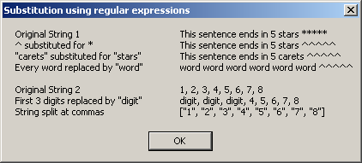
RegexSubstitution.cs
36 output += "\n\nOriginal String 2\t\t\t" + testString2;
37
38 output += "\nFirst 3 digits replaced by \"digit\"\t" +
39 testRegex2.Replace( testString2, "digit", 3 );
40
41 output += "\nString split at commas\t\t[";
42
43 results = Regex.Split( testString2, @",\s*" );
44
45 foreach ( string resultString in results )
46 {
47 output += "\"" + resultString + "\", ";
48 }
49
50 output = output.Substring( 0, output.Length - 2 ) + "]";
51
52 MessageBox.Show( output,
53 "Substitution using regular expressions" );
54
55 } // end method Main
56
57 } // end class RegexSubstitution

